Slide 1
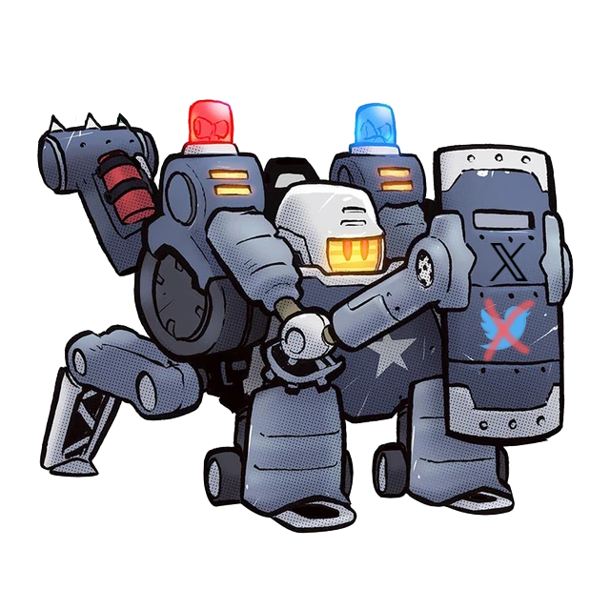
Police Bot
Enhancing Social Media Governance with Policing Bots

Slide 2
Group Members
Students:
Liam Dumbell
Gabriel Silva
Cody Manning
Faculty Advisor / Project Client:
Khaled Slhoub
Computer Science Project Instructor:
Dr. Phillip Chan

Slide 3
Motivation and Goal
Motivation
Social Media Sites have had a prolonged issue with malicious bot accounts
There is a need for a tool that can easily distinguish a bot account from a human as well as a malicious bot from a beneficial one.
Goal
Allow users to detect malicious bots more easily while still being able to take advantage of the useful bots.
Categorize bots by different levels of maliciousness
Properly report bots with a high level of maliciousness to the proper administrators

Slide 4
Key Features
The Three D’s:
Detect:
Allows users to detect artificial users (bots) on a social media platform.
Distinguish:
Allows users to distinguish beneficial bots from malicious ones.
Decide:
Allows users to determine the level of maliciousness of a bot account
Allows users to decide to report the account after determining that it is a bot and its level of maliciousness

Slide 5
Technical Challenges
Team members currently have:
No experience using and working with X/Twitter Virtual Environments.
Little experience using the Twitter API.
Little experience working with bots and no experience creating and detecting them.
No experience with the libraries or other methods for developing bots for social media platforms.
Insufficient HTML experience for the scope of this project.

Slide 6
Milestone 1 Oct 2
Compare and select technical tools
Tweepy Python library
OAuth 2.0 Flask Application Approach
Create small demos to evaluate the tools
Create simple Twitter Bots for both Tweepy and Flask App approach
Resolve technical challenges
Make progress on learning how to work with the Twitter API
Learn how to create simple Twitter Bots
Compare and select collaboration tools for software development, documents/presentations, communication, task calendar.
Create Requirement Document.
Create Design Document.
Create Test Plan.

Slide 7
Milestone 2 Oct 30
Implement, test, and demo the system used to compile data on accounts thought to be bots and store the account data locally to be analyzed.
Learn the Twitter API well enough to develop the rest of our features within the API
Detection of Bot accounts using account data
Distinguish beneficial bot accounts from malicious ones based on account interactions and posts
Decision system that determines if a bot account should be reported or not

Slide 8
Milestone 3 Nov 27
Decide on a method of detecting bot accounts.
Implement, test, and demo the tool to detect whether an account is run by a human or a bot based on our chosen method.

Slide 9
This concludes our presentation, Thank You

